Slide 1


DataBase Logic in Business Applications
Al.I. Cuza University of Iași
Faculty of Economics and Business Administration
Department of Accounting, Information Systems
and Statistics
Business Rules in PL/SQL (2)
By Marin Fotache & Co.

Slide 2
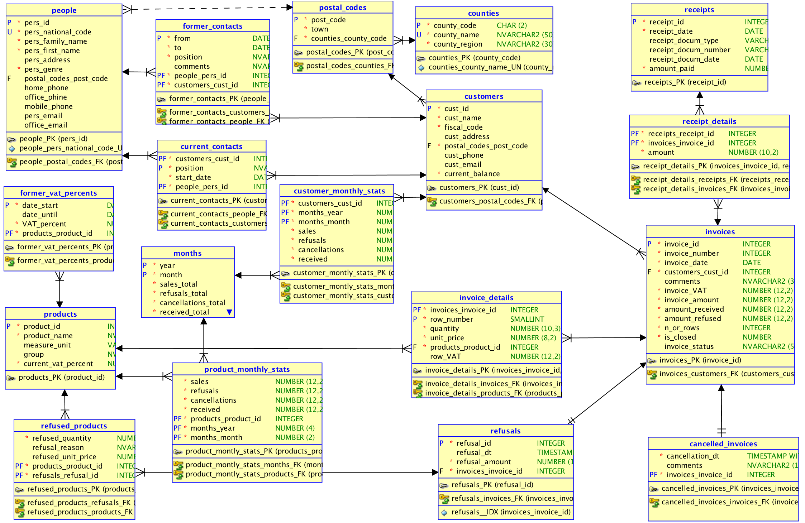
DB Schema

Slide 3
Scripts on GitHub
See section 07_Business Rules with PL SQL of the course:
https://github.com/marinfotache/Database-Logic-in-Business-Applications/tree/master/07_Business%20Rules%20with%20PL%20SQL
Prerequisites (for setting up the database to this point)
06-00-2_fixed_DDL_script_sales_2015.sql
06-00-3_add_constraints_sales_2015.sql
06-01a_en_sequences.sql
06-01b_en_data_cleaning__surrogate_keys.sql
06-01c_en_cascade_updates.sql
06-02a_en_triggers_invoices.sql
06-02b_en_triggers__invoice_details.sql
06-02c_en_triggers__receipts__receipts_details.sql
06-02d_en_proc_auto_ins__receipts.sql
06-03a_en_logs_and_triggers.sql
06-03b_en_general_log.sql
06-03c_en_protecting_denormalized_attributes.sql
07-01a_BusinessRules1__basic_BR.sql
07-01b_BusinessRules2__invoice_locking.sql
07-01c_BusinessRules3__inv_rows_numbers.sql

Slide 4
07-02a_BusinessRules4__closed_months.sql
Blocking/closing months (in Finance/Accounting)
After the general ledger, the VAT statements and other financial statements were finalized (that can happen monthly, quartely, twice a year or yearly), the operations incorporated in finished statements cannot be modified - financial-accounting closing
Other technical stuff:
at the end of a package body an anonymous block can be inserted; this will be executed once per session (at first call of a package variable, procedure or function
mutating tables (part II)

Slide 5
07-02b_BusinessRules5_control_user_edit_rights.sql
Controlling user access to records to be edited can be achieved through other technologies as well (not covered in this course):
Views
Virtual Private Databases (recommended)
Problem description: Internal users can have assigned group of entities (customers, students, employees...). They have the rights to edit the records only to allocated entities.
In SALES database, we'll give explicit rights for an user to update the invoices (refusals, payments) only of some specific customers.
Table "user_rights" assigns users to customers.
Tables "customers", "invoices", "invoice_detais", ... check if the user doing current updates has privileges (rights) for current customer's data

